Slide 1
“Evolution rather than Revolution”
Waste Services Transformation Programme
Oxford City Council
Climate and Environment Panel
26 February 2025

Slide 2
2024 Service Review Activist Group Work
Explore the appetite to collaborate
Make a judgement on compatibility
Begin to understand the size of the prize
Undertake a review of the WODC contract

Slide 3
The Landscape
Inflationary pressures
Housing Growth and a desire to turbo charge
Legislative Impact - Emissions Trading Scheme
Legislative Impact – EPR + Simpler Recycling

Slide 4
The numbers
Oxfordshire spends c£70M on waste and environmental services
We generate circa c£20M
Oxfordshire District Council Costs above national average
Oxfordshire County Council below national average
One of the top performing cities and counties in the UK, but now flatlining

Slide 5
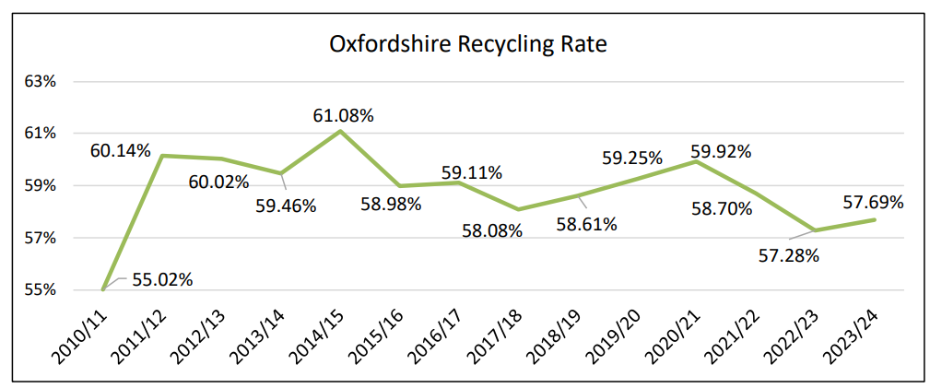
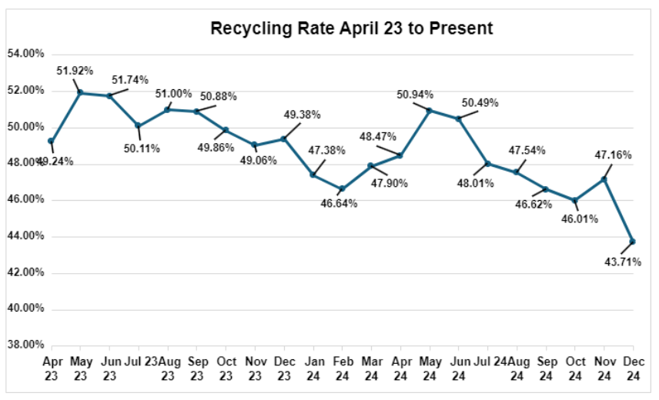
Recycling rates
Oxford

Slide 6
Approach
We have already demonstrated to benefits of collaborating - on DMR procurement with WODC – c£500k saving
There is an appetite to collaborate, building on ORWP and political climate ambitions
Between £1M & £3M in efficiencies for City/CDC/WODC/County
Programme agreed to develop full Business Case for joint operations + roadmap of S/M/L projects to deliver efficiencies
ODS also developing commercial waste offering in partnership with CDC and WODC
Simpler Recycling assessment being undertaken by ORWP – potential opportunity to move to 3 weekly residual/fortnightly recycling/weekly foodwaste collections – known as 321

Slide 7
Next Steps (Jan-Jun 25)
CEOs: “Evolution not Revolution. Get on with it”
Joint Programme Board involving City/CDC/WODC/County
Twin-track Full Business Case development and identification of ongoing efficiencies

